Slide 1
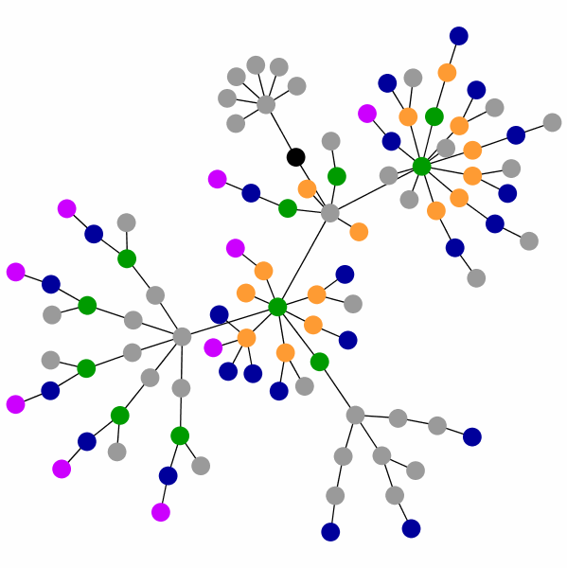
Cancer
Lesson 3.5
How do cancer cells evolve?

Slide 2
Do Now
What are examples of the kinds of driver genes that need to be mutated to transform cells?

Slide 3
Do Now
Genes that regulate survival and death
Genes that regulate ageing
Genes that regulate proliferation
Genes that regulate invasiveness

Slide 4
Three driver mutations needed for transformation
Tumor
Tumor suppressor
Telomerase
Survival ⬆⬆
Apoptosis
Aging
Mutation 1
Mutation 2
Mutation 3
Proliferation ⬆⬆
Aging
Aging
Oncogene
Normal
cell

Slide 5
Carcinogens increase mutation frequency
Tumor
UV
Normal
cell
How would carcinogens affect tumor cells?

Slide 6
Do you think this is an accurate picture?
Tumor
Normal
cell
Tumor
Normal
cell

Slide 7
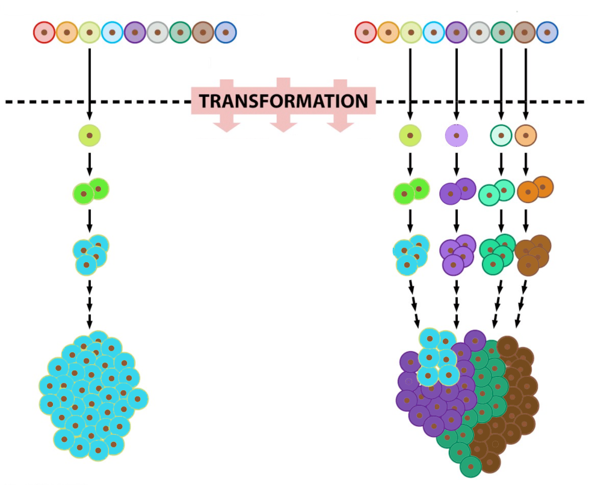
An evolving view of tumors
Epithelial cells
1
1
2
2
3
3
Monoclonal tumor
Polyclonal tumor

Slide 8
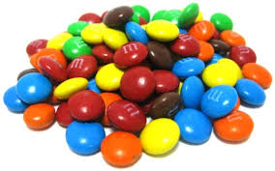
Tumors are heterogeneous!
Each tumor cell has multiple different mutations
Tumor cells compete with each other
Survival of the fittest!
Notes:
Replacing this image with a different one for heterogeneity..students didn’t relate with this one..

Slide 9
Activity
Treating a tumor with chemotherapy.

Slide 10
Wrap Up: Arrange tumors in a time line
Arrange the tumor to show how it grows (Step 2) and how treating it with drugs affects it (Step 3).
Remember the blue yellow and pink cells contain multiple different types of mutation.

Slide 11
Tumor mutations
Step 1
Step 2
Step 3
Step 1: The tumor has 3 kinds of cells.
Step 2: The blue cells are growing fastest.
Step 3: The drug killed the blue cells,
but the pink cells and the yellow cells have survived.

Slide 12
What will happen next?
Before
Later
What will happen to the pink and yellow cells?
What will be the result for the tumor?

Slide 13
Wrap Up: Polyclonal tumors are harder to treat
Polyclonal tumor

Slide 14
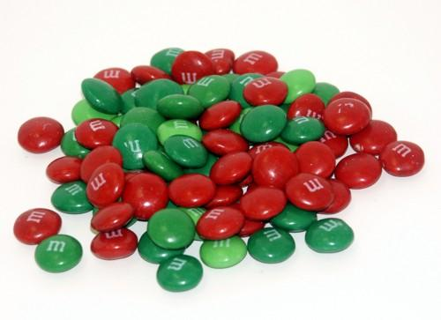
Chemotherapies select for new bad guys!
Before
After
Drug
They may grow slower but they may spread better

Slide 15
Homework
Read an article from the Daily Telegraph about how cancers constantly become resistant to chemotherapies.

